Slide 1


Slide 2


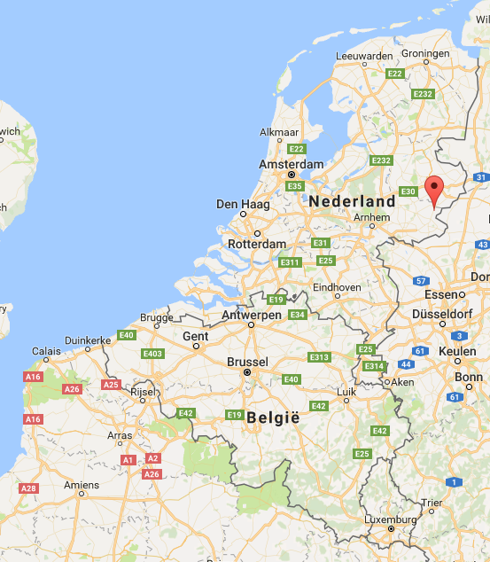
About me
Backend developer. Kotlin, Java
Working @ Nedap Retail
Living in the Achterhoek
Working on scalable backends
  Apache Storm
  Apache Kafka
  Apache Cassandra
Waatze Goldewijk

Slide 3

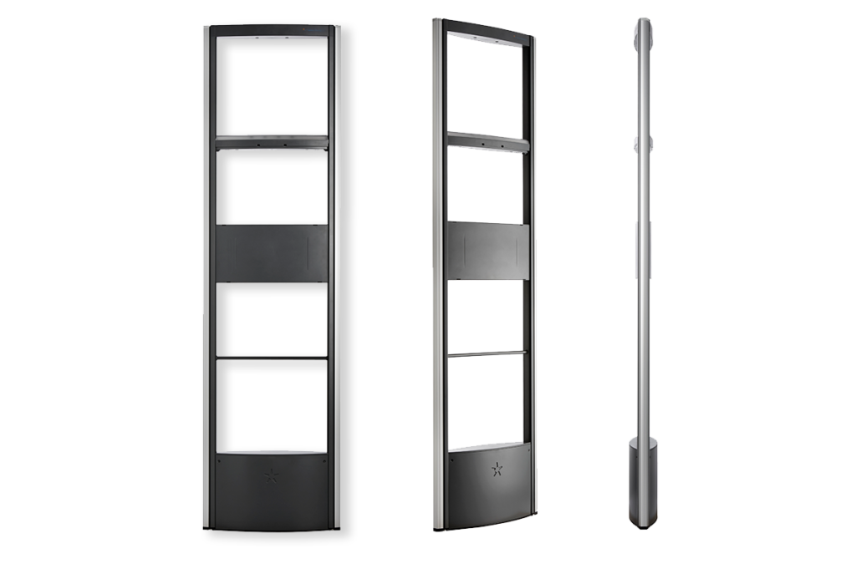


Apache Storm?

Slide 4

Apache Storm?
Key concepts
Cluster architecture
Demo

Slide 5
What is Apache Storm?
Stream processor
Built at Backtype
Acquired and open sourced by Twitter
Apache Top-Level project since 2014
Used by:
  Twitter
  Spotify
  Nedap

Slide 6
Problems it solves
Simple API
Flexible scaling
At-least-once processing
Fault tolerance, no single point of failure

Slide 7
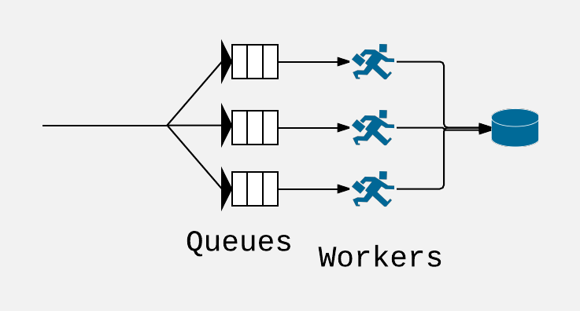
Worker - queue paradigm
Queue partitioning determines scalability
Workers coupled to partitions
Result:
Scaling is painful, manual, labor intensive

Slide 8
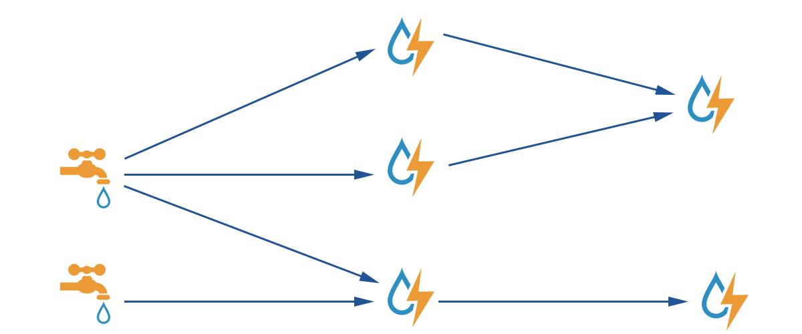
Core concepts

Slide 9
Topology
Spouts
Bolts
Bolts

Slide 10

Spout
Unbounded stream of input
Built-in support for
  Apache Kafka
  Apache Trident
  HDFS
  ...
Or easily build your own
Tuple tracking

Slide 11

Bolt
Single tuple at a time
Receives from spout, bolt or interval
Function on a tuple
Used for:
  filtering
  grouping
  calculations
  storage/retrieval in caches/DB
  …
Acks each tuple (or fails)

Slide 12
Stream
Connects spouts and bolts
Internally a queue+sockets (Netty)
Grouping
  shuffle
  by tuple field

Slide 13

Topology
Definition of spouts, bolts and streams
Parallelism
Compiled and uploaded to Nimbus

Slide 14
Guarantees
At least once processing
No single point of failure

Slide 15
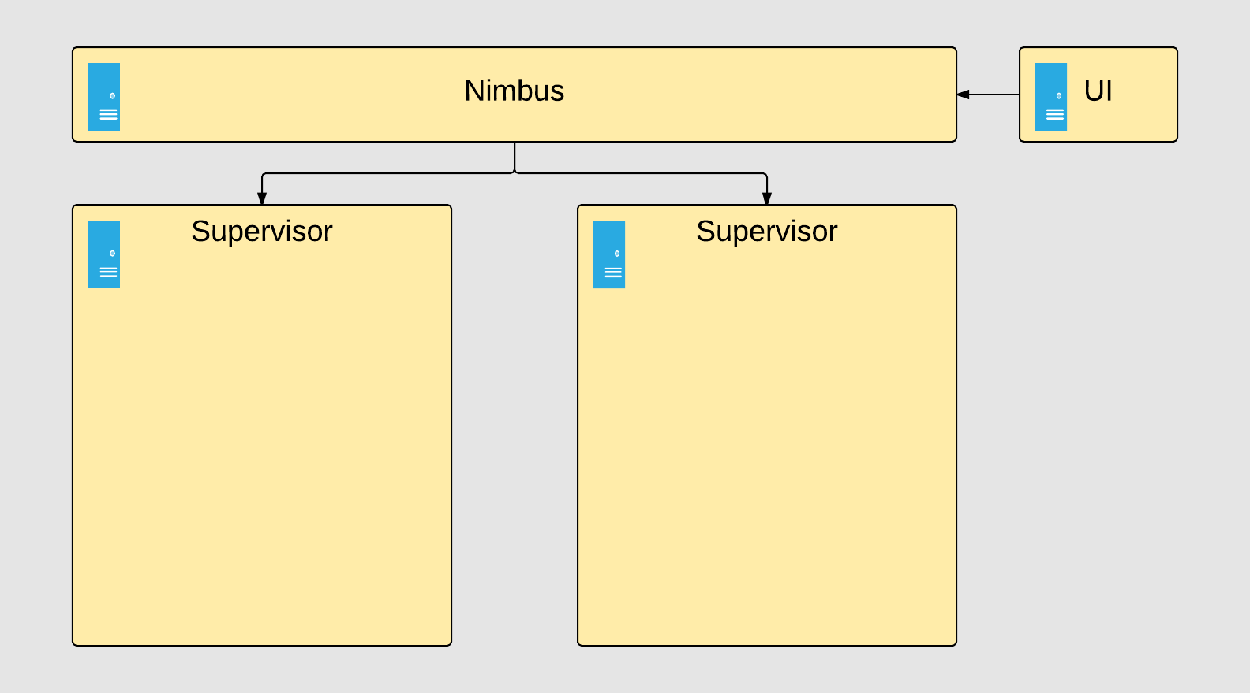
Cluster architecture

Slide 16
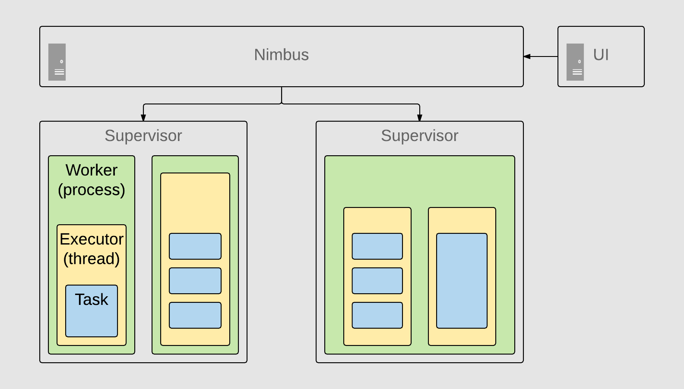
Cluster architecture

Slide 17
Nimbus
Supervisor
Executor
Task
Leader node
Manages and monitors supervisors (worker nodes)
Distributes topologies
Worker node running Storm
Manages worker processes
Thread within a worker process
Instance of a bolt/spout within a thread

Slide 18
Scaling
Increase workers
Add supervisors
Each spout or bolt scales independently
Use UI for bottlenecks

Slide 19
Apache Storm @Nedap Retail
22000+ devices across the globe
+/- 1000 events/sec
Calculating statistics
  Number of visitors
  Dwell time
  Device malfunctions
Storage in Apache Cassandra
1 Nimbus
3 Supervisor nodes (16 core, 128GB RAM)
11 topologies

Slide 20
Demo time: distributed word counter
Docker environment
Input: All works by Shakespeare in a single TXT-file
Read from TXT file
Split into words
Filter words < 3 characters
Count each word, sleep (!!!) 1ms
On interval: persist to Redis database

Slide 21


Contact me
@waatze waatze@goldewijk.net
Sources
https://github.com/WaatzeG/t-dose2017

